Slide 1
Entity Relationship Diagrams (ERDs)
DBMS-1002

Slide 2




In These Slides . . .
We will be covering:
How to read an Entity Relationship Diagram (ERD)
Defining relationships between multiple tables
Understanding Cardinality Relationships:
One-to-One
One-to-Many / Many-to-One
Many-to-Many
Using cardinality symbols:

Slide 3
Entity Relationship Diagrams (ERDs)
An ERD is an image that describes the tables and their relationships.
They allow us to understand a database at a glance.
The diagram describes data as:
Entities (tables)
Attributes (columns)
Relationships (cardinalities)

Slide 4
Entities
Entities are “things” in the real world that can be described.
They can be a physical object in the real world:
Example: car, hockey player, house
They can be more conceptual:
Example: flight, team, company
Ultimately an Entity will be made into a table in our database.

Slide 5
Attributes (Properties)
An Attribute (or property) is a piece of information for an Entity.
They can be a Primary Key (PK) or Foreign Key [FK].
Ultimately an attribute will be a column on a table.
Example attributes: First Name, Last Name, Salary, Department ID, Hire Date
What ENTITY would this be?
Notes:
Obviously an Employee!

Slide 6
Relationships
A Relationship occurs between two tables when a foreign key appears on one table referencing a primary key on another table.
There are several kinds of relationships:
One-to-Many / Many-to-One
One-to-One
Many-to-Many (only theoretical)

Slide 7
Relationships - One-to-Many
A One-to-Many (or Many-to-One) relationship occurs between two tables when a row on one table is related to one or more rows in another table.
A Primary Key column value from one table’s row is referenced by one or more rows in another table.
This is the most common!
Table 2
Table 1
1 XXXX XXXX
1 XXXX XXXX
2 XXXX XXXX
1 XXXX XXXX
1 XXXX
2 XXXX

Slide 8
Relationships - One-to-Many
In the below example we have owners and their pets!
One pet owner can have many pets!
While a pet can only have one owner.
The Foreign Key [FK] on the Pet Table (id) references the Primary Key (PK) on the Pet Owner table (id).
How many pets does Monica have? How many does Steve have?
[FK]
pet_id pet_name owner_id
------ ---------- ------------
100 Snowy 1
101 Rex 1
102 Midnight 2
103 Astro 1
owner_id(PK) name
------------- --------
1 Monica
2 Steve
3 Jaspreet

Slide 9
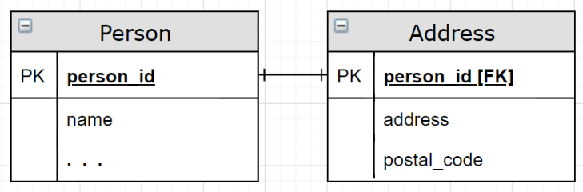
Relationships - One-to-One
A One-to-One relationship occurs between two tables when one row on one table is directly related to a single row in another table.
The Primary Key may be the same on both tables.
This makes the parent/child relationship a bit confusing.
IT IS RARE, but let’s see an example…

Slide 10
Relationships - One-to-One
In the below example we have people and their address information
Person Table
Address Table
p_id name …
---- -------- --
1 Monica …
2 Steve …
3 Jaspreet …
p_id[FK] address postal
-------- -------------- -------
1 555 Market Ave A5G 1X5
2 111 Meow Rd Q7A 3T1
3 321 50th St T3S 4M2
The Primary Key column is p_id (person_id) on both tables.
The Address Table’s p_id is also a foreign key referencing the Person Table.
Try it! Does this relationship reflect our real world?
NO! It is possible to have more than one person living at a single address
Notes:
We abbreviated person_id to p_id to reduce vertical space on the slides!

Slide 11
Relationships - One-to-One
Could we put the address columns into the first table if all the non-key columns are associated with the same unique value?
Yes we can! This is even preferred. So, why 2 tables?
Less clutter in a single table (reduced columns in a table).
Less data returned in commonly run queries:
Example: SELECT from the Person table might be very common
Person Table
p_id name address postal …
---- ---------- -------------- ------- ---
1 Monica 555 Market Ave A5G 1X5 …
2 Steve 111 Meow Rd Q7A 3T1 …
3 Jaspreet 321 50th St T3S 4M2 …

Slide 12
Relationships - Many-to-Many
A Many-to-Many relationship occurs between two tables when a row in one table can be associated with one or more rows in another table and vice-versa.
We can only have this kind of relationship in theory!
During the brainstorming phase of database creation or when talking about relationships at a glance.
Let’s see why with an example…

Slide 13
Relationships - Many-to-Many
Let’s change our old rules for pets and their owners:
A pet owner can have MANY pets (this is the same). A pet can now have more than one owner! (new).
How do we change this?
pet_id pet_name owner_id
------ --------- -------
100 Snowy 1
101 Rex 1
102 Midnight 2
103 Astro 1
owner_id name
-------- --------
1 Monica
2 Steve
3 Jaspreet

Slide 14
Relationships - Many-to-Many
What if we add columns to the pet table for each owner?
What happens if we have 10 owners? 100? When do we stop?
We see a NULL whenever a pet does not have an owner. The more owner columns, the more NULLs.
Adding columns to tables is not scalable! So what can we do?
pet_id pet_name owner_id1 owner_id2 owner_id3 …
------ -------- --------- --------- --------- ---
100 Snowy 1 2 3 …
101 Rex 1 2 NULL …
102 Midnight 2 NULL NULL …
103 Astro 1 NULL NULL …
YUCKY!
WRONG!
NO!
Notes:
The NULLs happen when pet’s have less owners than other pets.

Slide 15
Relationships - Many-to-Many
We have to create a third table!
This joiner table will reference the primary keys on both sides!
Now a pet can be owned by many pet owners!
Note: both columns in the new table are Foreign Keys!
pet_id pet_name
------ ---------
100 Snowy
101 Rex
102 Midnight
103 Astro
pet_id owner_id
------ --------
100 1
100 2
100 3
101 1
101 2
102 2
103 1
owner_id name
-------- --------
1 Monica
2 Steve
3 Jaspreet
Notes:
The NULLs happen when pet’s have less owners than other pets.

Slide 16
Relationships - Many-to-Many
The new table needs to declare a Primary Key!
Option A: Make a COMPOSITE primary key from the 2 Foreign Keys!
Option B: Add an auto incrementing SURROGATE primary key!
pet_id(PK) owner_id(PK)
------ ------------
100 1
100 2
100 3
101 1
101 2
102 2
103 1
id (PK) pet_id owner_id
------- ------ ---------
1 100 1
2 100 2
3 100 3
4 101 1
5 101 2
6 102 2
7 103 1
Notes:
The NULLs happen when pet’s have less owners than other pets.

Slide 17
Relationships - ERD
Now that we have seen some of the relationships in practice, let’s see what they look like on an Entity Relationship Diagram (ERD)!

Slide 18
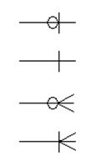
Relationships - Cardinalities
Cardinalities are symbols used in an ERD to describe a specific relationship between the tables:
Note: the Symbols can be shown in any direction.
Zero to One
One and Only One
Zero to Many
One to Many

Slide 19
Relationships - Cardinalities
These Cardinalities come from the business rules defined by whoever is making the database.
Example Rules: What are the cardinalities we must use?
A Student might not own a Textbook, but can own many.
A Textbook might not be owned, but can only be owned by one Student.
Zero to One
One and Only One
Zero to Many
One to Many
Notes:
next slide for answers...

Slide 20


Relationships - Cardinalities
Example Rules -> matched with the right cardinality:
A Student might not own a Textbook, but can own many.
Students can have zero or more ( ) Textbooks.
A Textbook might not be owned, but can only be owned by one Student.
Textbooks can have 0 or one ( ) Students.

Slide 21
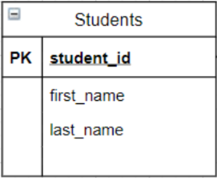
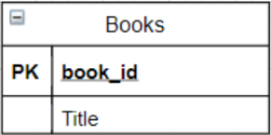
Relationships - Cardinalities
Before we can show the cardinalities in an ERD, let’s clarify:
Entities with their attributes:
Where student_id and book_id will be our primary keys (PK).
But where do we put the foreign key(s) [FK] to represent our table relationship?

Slide 22
Relationships - Cardinalities
A student can have many books.
Can we add a column to Students for each book id?
NO!
We saw how that failed earlier with pets and their many owners.
For each book_id column, a student could own another book.
We need infinite room! So this cannot work here.

Slide 23
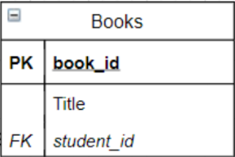

Relationships - Cardinalities
A textbook can only have one student owner.
Can we add a column to the Books table to represent a single student id value?
One column for one value...
Yes!
(This Is The Way! )

Slide 24
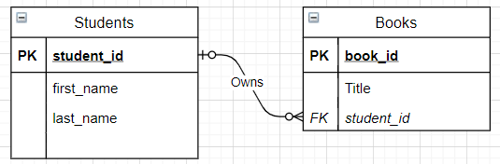
Relationships in an ERD
Here we have our finished example:
A Verb is used on the relationship line that connects the Foreign Key [FK] column to the Primary Key (PK) column.
This is a One-to-Many relationship!

Slide 25
Relationships in an ERD
Notice that the MANY connection comes off of the table with the foreign key.
IMPORTANT: The Foreign Key is on the MANY side of the relationship. This is ALWAYS true!
Notes:
The Student table is the parent! The Books is the child!

Slide 26
Relationships in an ERD
Relationships are read in any direction, however, note that we skip the first cardinality when saying it out loud:
Left to Right: Students can own zero or more ( ) Textbooks.
Right to Left: Books can be owned by 0 or one ( ) Students.

Slide 27
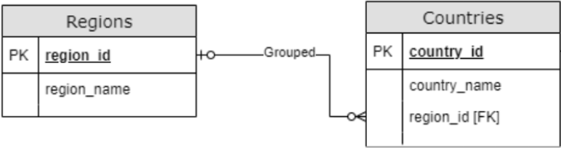
Relationships in an ERD
Here’s another example from our course ERD:
Regions group 0 or many ( ) Countries.
Countries are grouped into 0 or 1 ( ) Region.
What kind of relationship is this?
Which table is the parent? Which is the child?
Notes:
It is ALSO a one-to-many, parent is Regions, child is Countries.

Slide 28
Relationships in an ERD
Let’s change our business rules again!
New Rules:
A Student might not own a Textbook, but can own many Textbooks.
A Textbook might not be owned, but can be owned by many Students.
What are the cardinalities now?

Slide 29
Relationships - Cardinalities
Example Rules -> matched with the right cardinality:
A Student might not own a Textbook, but can own many Textbooks.
Students can have zero or many( ) Textbooks.
A Textbook might not be owned, but can be owned by many Students.
Textbooks can have 0 or many ( ) Students.

Slide 30
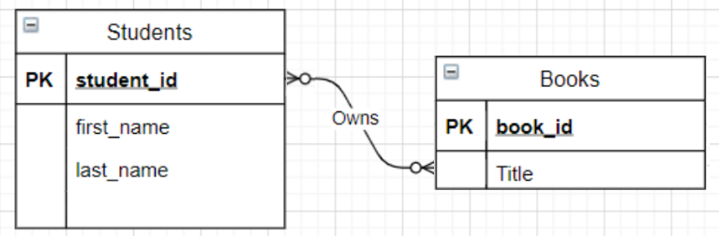
Relationships in an ERD
This is what our entities look like without foreign keys:
This is a Many-to-Many relationship!
This is fine as a theoretical diagram, but we need Foreign Keys if we want to be able to implement it into a real database.
Many-to-Many relationships MUST be resolved

Slide 31
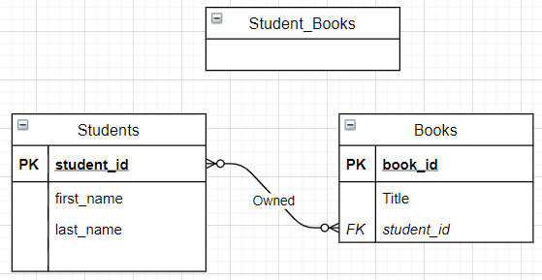
Relationships in an ERD
To make this work, we need to add a third table:

Slide 32
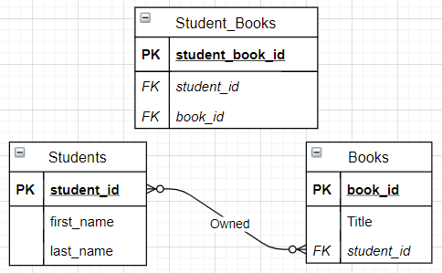
Relationships in an ERD
Take the old primary keys and use them as foreign keys:
NOTE: I used a surrogate PK here! I could have also created a composite PK which has the advantage of not having to add an extra column.

Slide 33
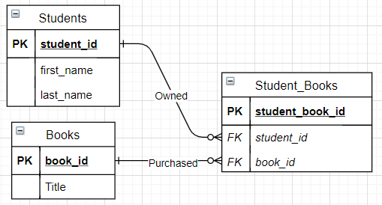
Relationships in an ERD
Copy the lines over to the new table and change the cardinalities coming out of Books/Student to One and Only One ( )

Slide 34
Relationships in an ERD
Our final result will always show the MANY connections coming out of the new table because that’s where the foreign keys are.

Slide 35


Course ERD
We can now read an Entity Relationship Diagram (ERD).
There are Entities:
Attributes:
and Relationships:

Slide 36
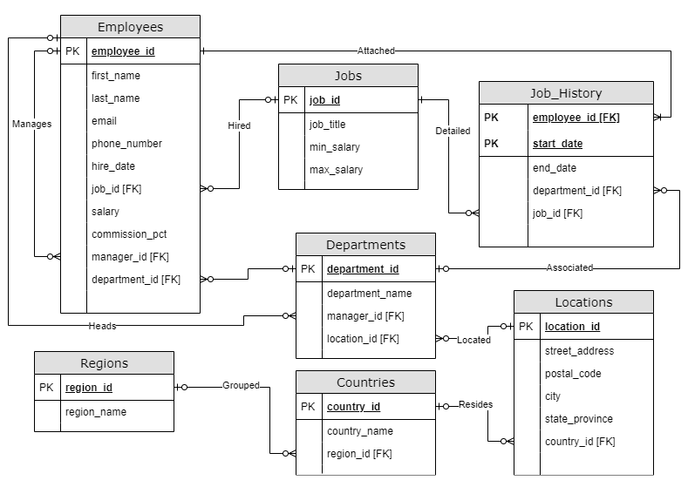
Now our Course ERD will be easier to read:

Slide 37
ERD - Example
TRY IT!
Create an ERD based on the following business rules:
A Game is produced by 1 or more programmers.
A Programmer can produce 0 or more Games.
Games have a game id, title, and rating. Programmers have a programmer id, and name.
You should: Label lines with appropriate cardinalities on each end Break up many-to-many relationships Assign foreign keys to the right tables

Slide 38
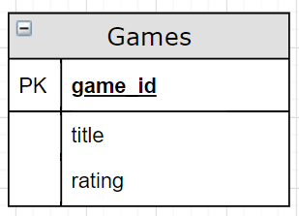
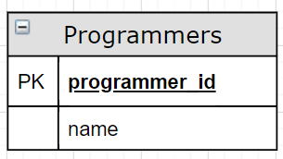
ERD - Example SOLUTION
Games have a game id, title, and rating.
We choose game_id for the Primary Key (PK).
Programmers have a programmer id, and name.
We choose programmer_id for the Primary Key (PK).

Slide 39
ERD - Example SOLUTION
A Game is produced by 1 or more programmers:
A Programmer can produce 0 or more Games:

Slide 40
ERD - Example SOLUTION
Put them together and we have:
IMPORTANT: To resolve this Many-to-Many relationship, we will need a third table...

Slide 41
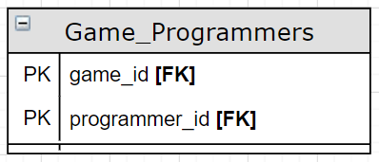
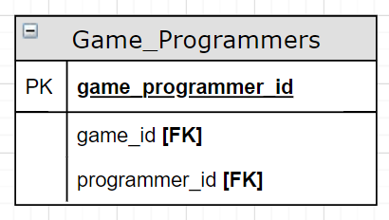
ERD - Example SOLUTION
The new table (Game_Programmers) will reference the other two tables by declaring each of their PK’s as FKs.
The new table also needs its own primary key, it can be either:
A Composite Key using the game_id and programmer_id
Advantages: One less column needed. Less server space required. Potentially faster queries.
A Surrogate Key made specifically for this table.
OR

Slide 42
ERD - Example SOLUTION
Now we create lines and cardinalities to point to the new table:
Remember that the original cardinalities went in these directions:

Slide 43
ERD - Example SOLUTION
Now we create lines and cardinalities to point to the new table:
Move each symbol to the far side of the new entity

Slide 44
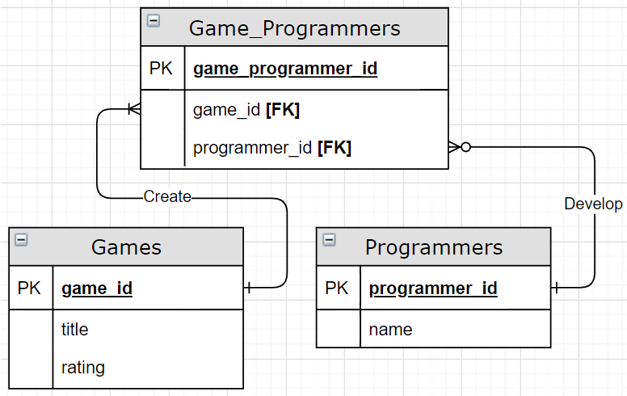
ERD - Example SOLUTION
Notice that the cardinality coming out of the original tables is: one and only one ( )
Note: We used a verb to describe each line.

Slide 45
ERD - Example SOLUTION - Finished!
Our finished ERD:

Slide 46
Summary
We covered:
How to read an Entity Relationship Diagram (ERD)
Defining relationships between multiple tables
Understanding Cardinality Relationships:
One-to-One
One-to-Many / Many-to-One
Many-to-Many
Using cardinality symbols:

